Slide 1
Fine-mapping
SMARTbiomed Summer School 2025
Dr Isabelle McGrath
Postdoctoral Researcher, University of Oxford

Slide 2
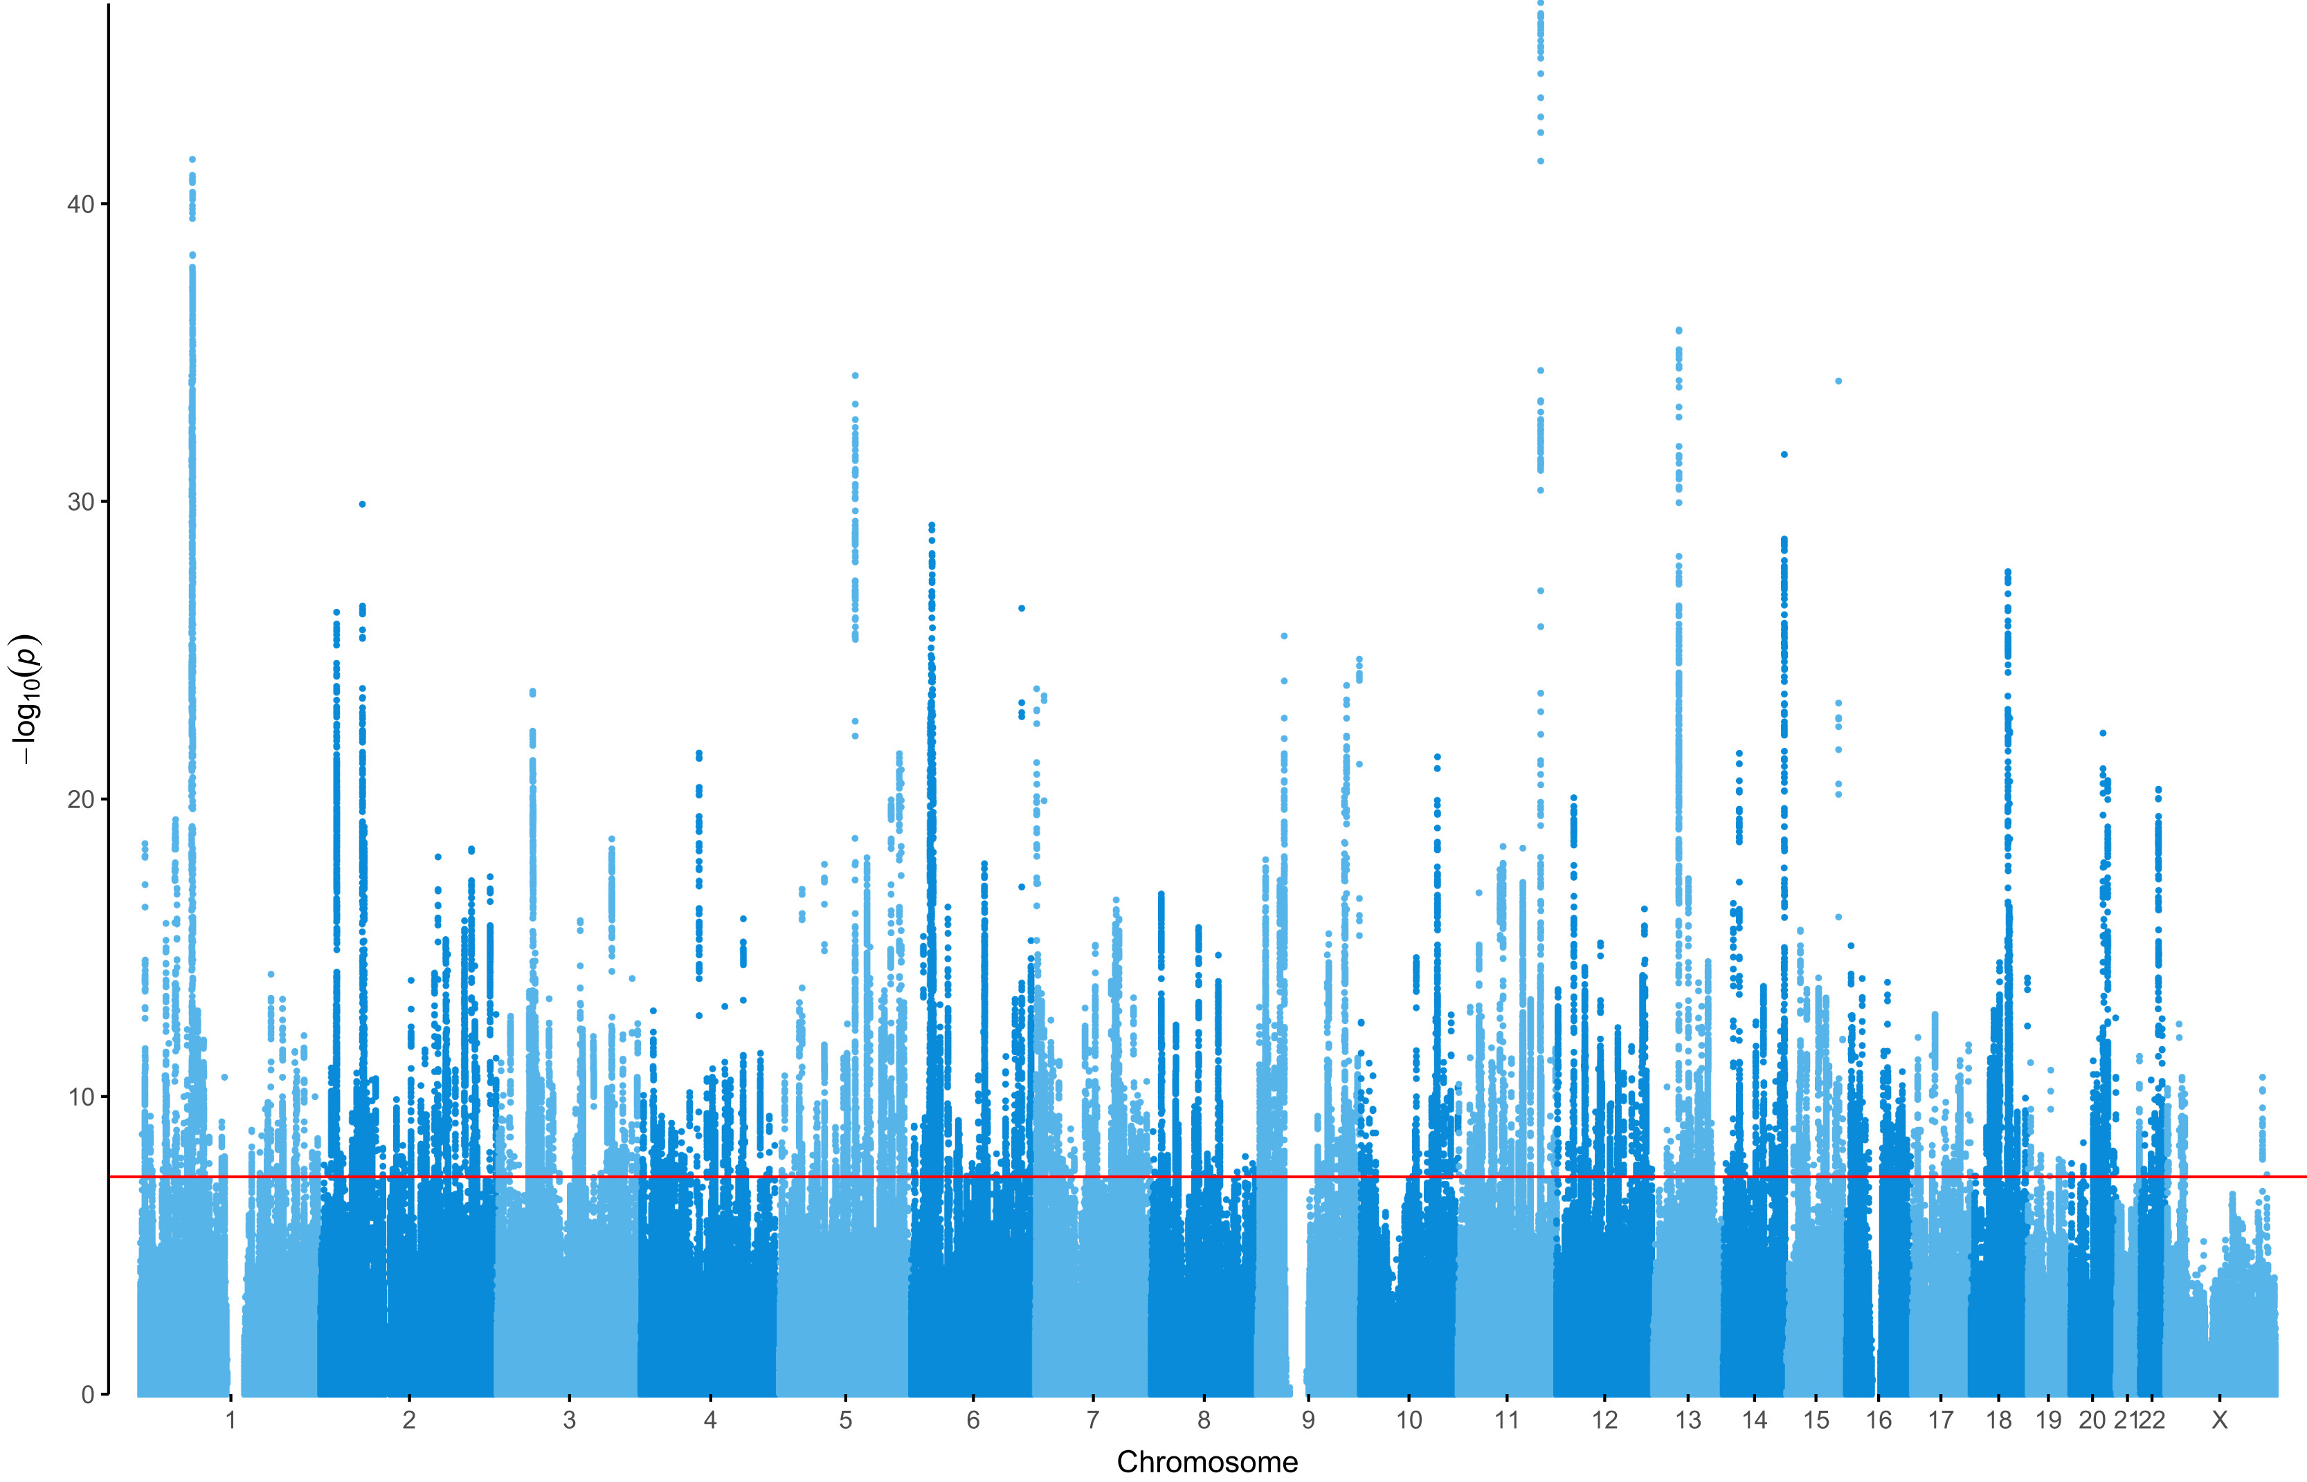
Overview
Linkage disequilibrium recap
Why fine-map?
Approaches to fine-mapping
SuSiE
Other fine-mapping tools
Practical

Slide 3
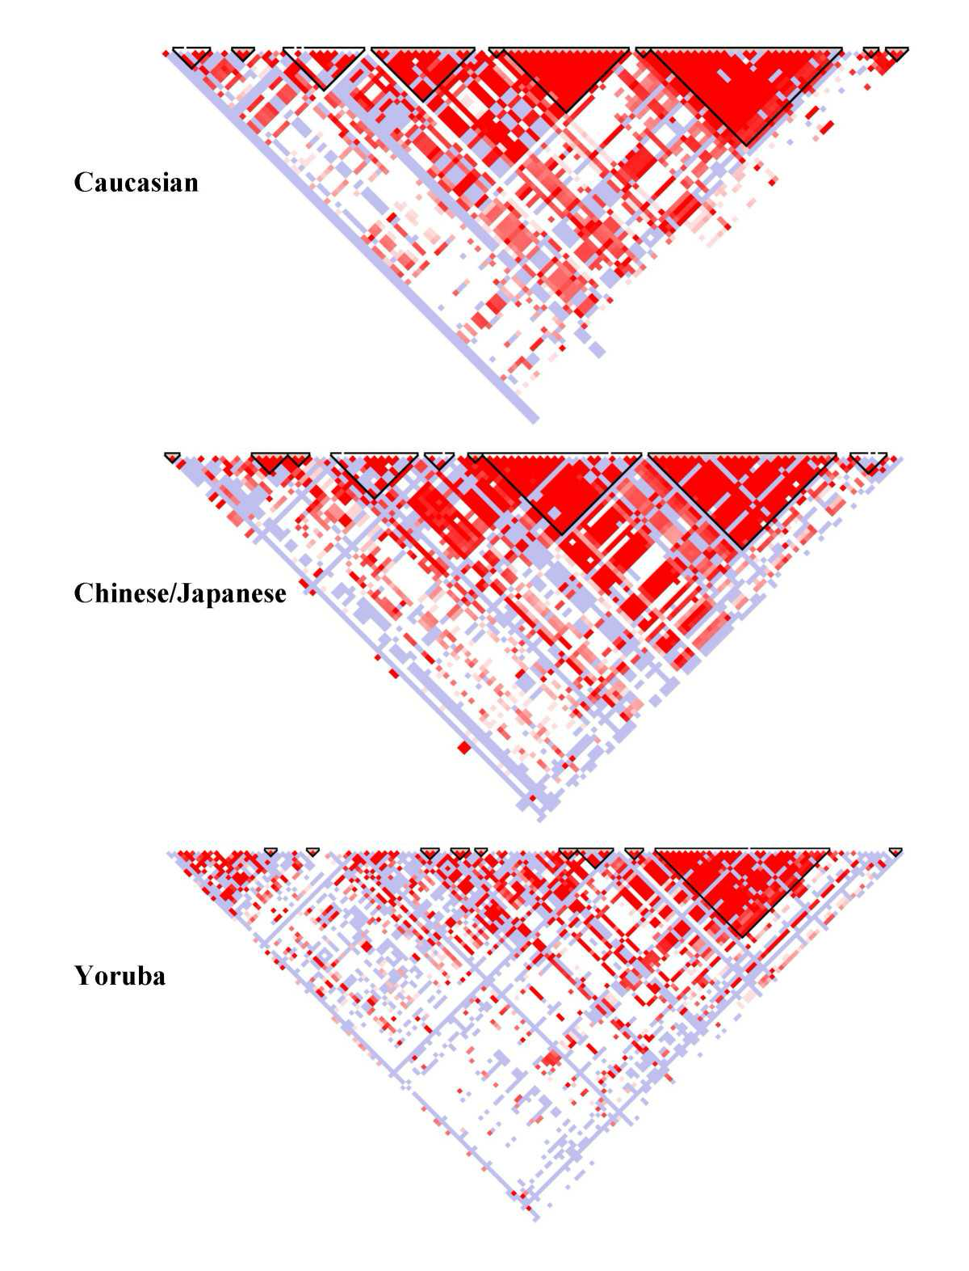
Linkage Disequilibrium
Non-random co-occurrence of alleles at different loci in a population
https://www.genome.gov/genetics-glossary/Crossing-Over
https://pages.graphics.cs.wisc.edu/765-10/files/2010/02/moz-screenshot-141.jpg

Slide 4
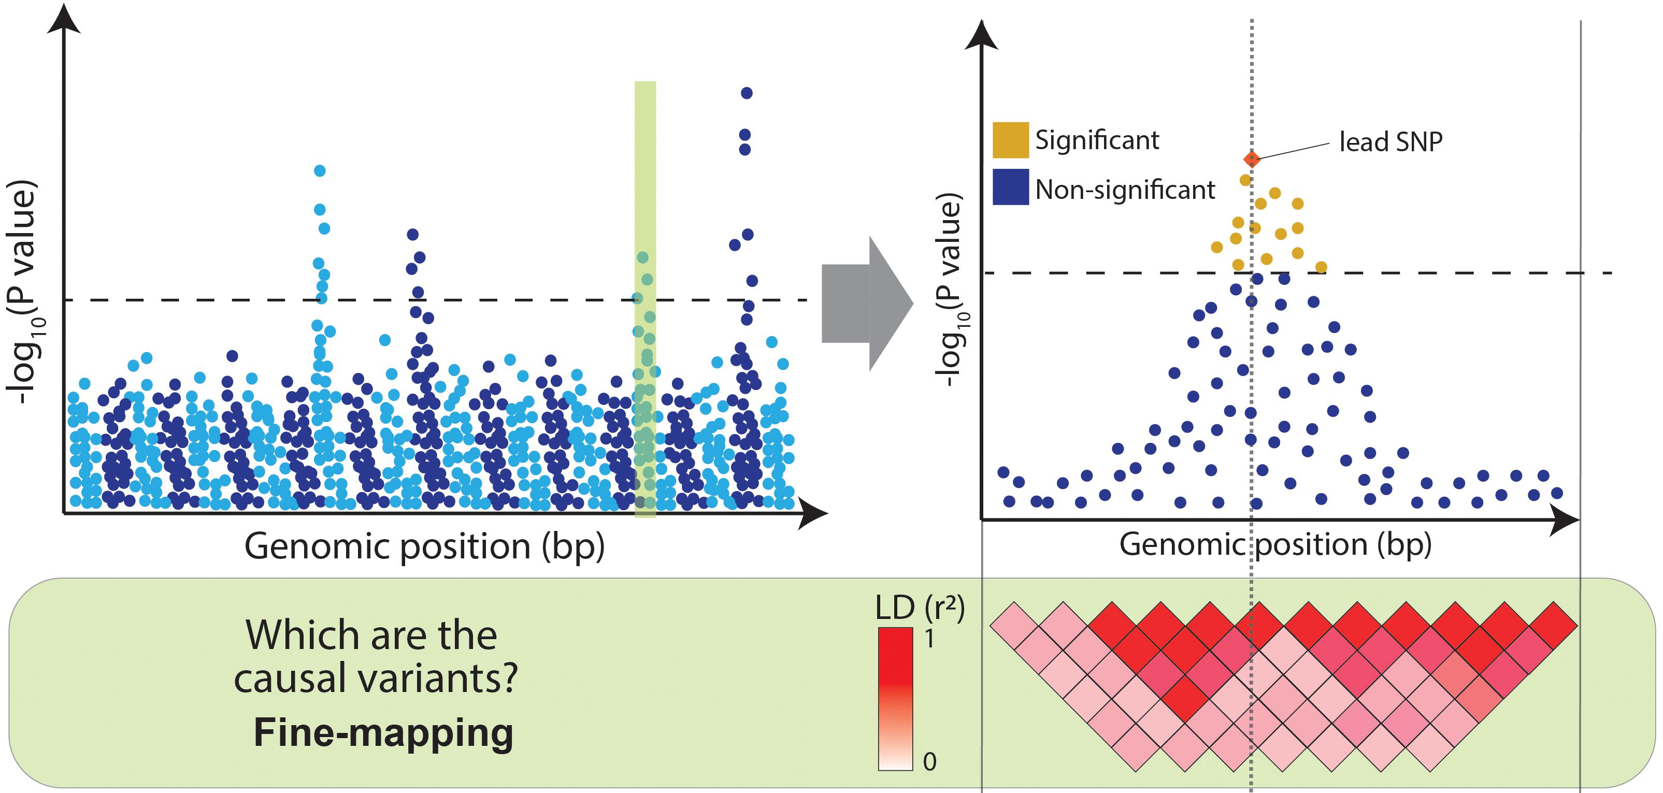
Why fine-map?
GWASs produce “towers” of associations due to LD
Many SNPs in the towers will not be causal variants
Fine-mapping = narrowing down association signals to those most likely to be causal
Cano-Gamez, 2020

Slide 5
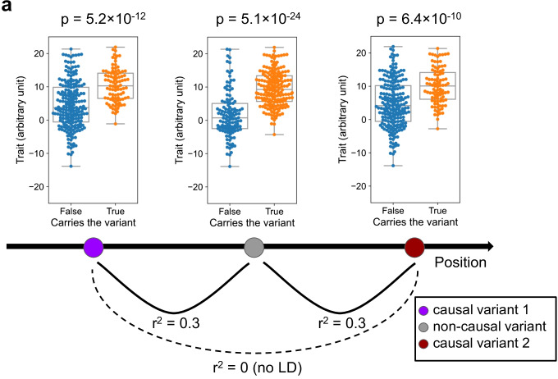
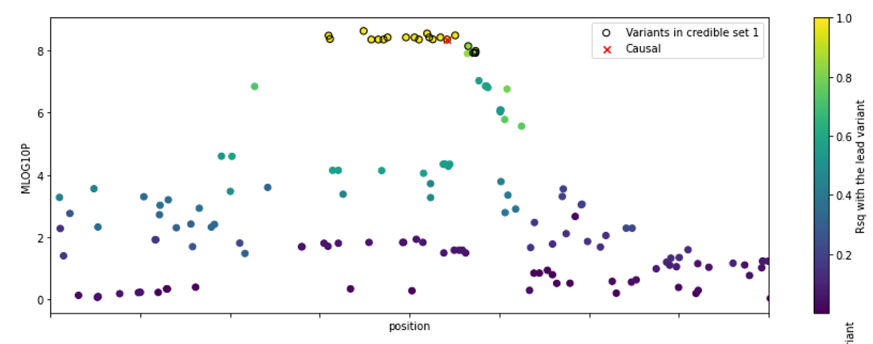
Why isn’t the top associated SNP always the causal variant?
Linkage disequilibrium
Statistical Noise
Not present in GWAS
Causal variant
☹
Wang, 2022
https://cloufield.github.io/GWASTutorial/12_fine_mapping/

Slide 6
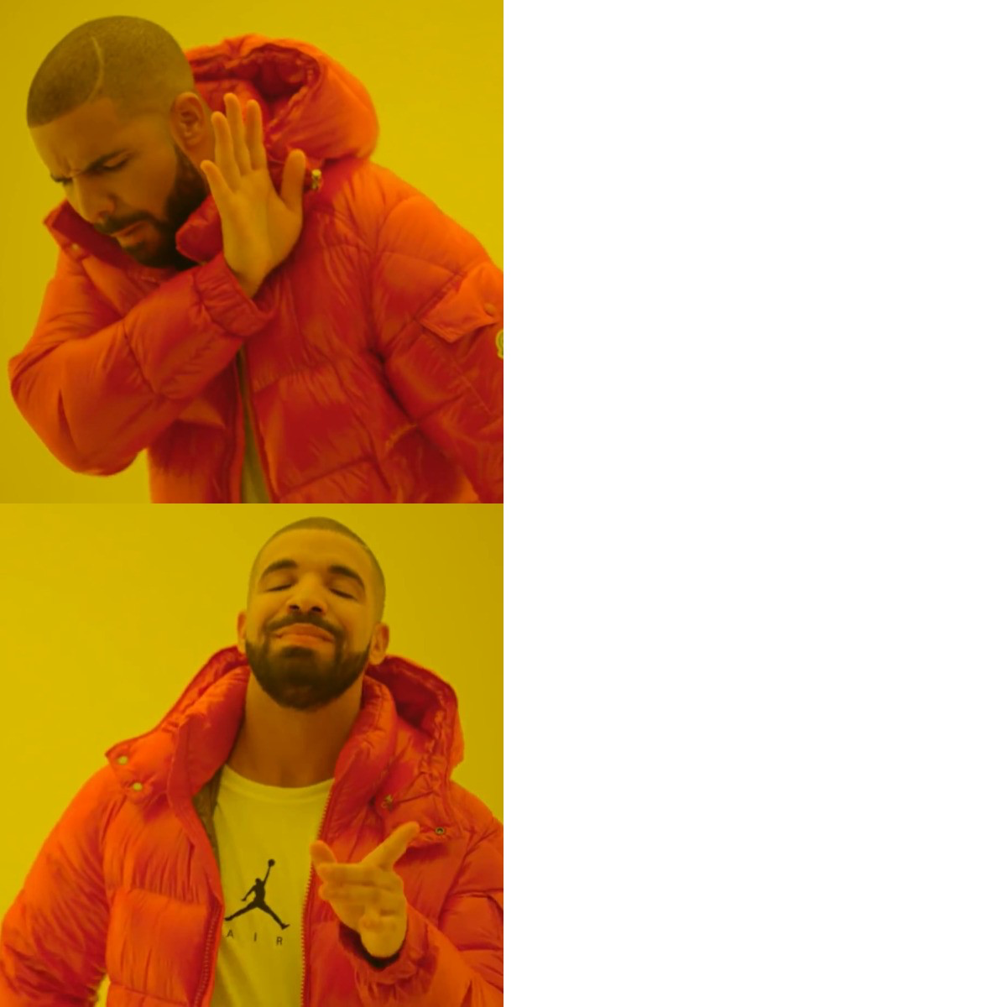
Why is the causal SNP useful?
What we do need it for:
Understanding biology ✨
Therapeutic development
Pleiotropy
Designing lab experiments
What we don’t need it for:
Identifying associated loci
Estimating heritability
Estimating genetic correlation
What it helps:
Polygenic risk scores
Tag SNPs
Causal SNPs

Slide 7
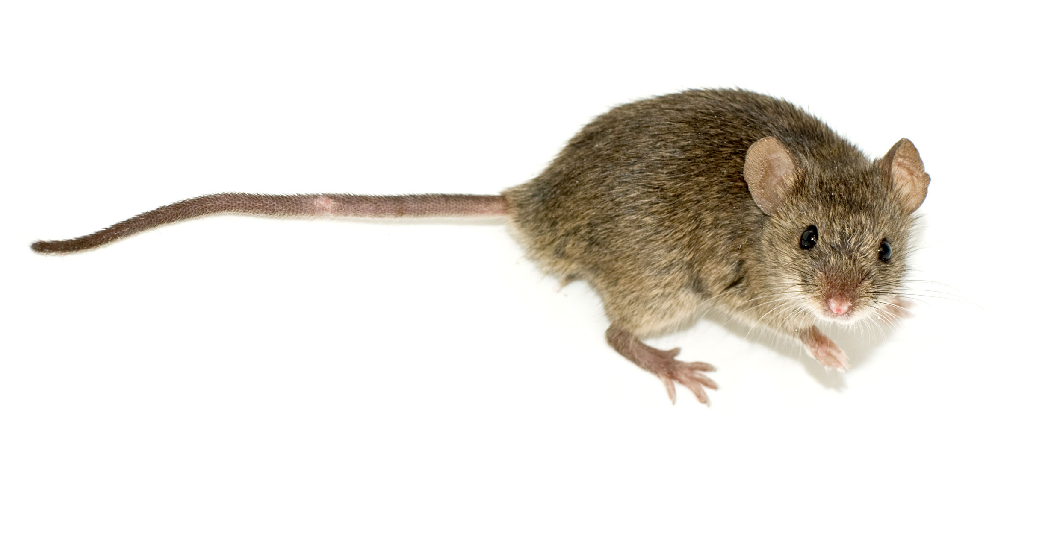
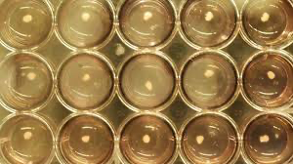
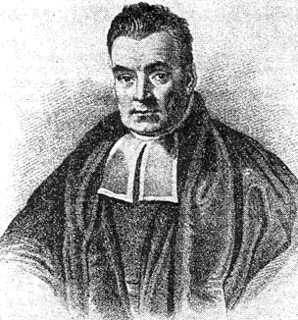
Approaches to fine-mapping
Functional assays
Test each significant SNP in a locus one-by-one in model system (e.g. MPRA)
Expensive, time consuming, small effects, unsure of how to measure effect
Not a perfect proxy for human physiology
More feasible after statistical fine-mapping
Frequentist approach
Test the effect each SNP on the phenotype while conditioning on other SNPs
Ignores uncertainty in variable selection
Bayesian approach
Provides a probability a variant is causal – can easily compare variants
Can incorporate prior knowledge

Slide 8
Single causal variant fine-mapping
Assumes a GWAS association signal contains one causal variant
Bayes factor (BF): compares the marginal likelihood of the data at that SNP
No information on LD is needed
$${PIP}_{i}= \frac{{BF}_{i}}{\sum_{j=1}^{p}{{BF}_{j}}}$$
$${BF}_{i}=\frac{p\left(Data \right| SNP i is causal)}{p\left(Data \right| no SNP is causal)}$$
PIP: probability a SNP is causal given the observed data
$$SNP i=1,…,p$$

Slide 9
Credible sets
Typically, no one variant stands out from the rest – solution: create “credible sets” of causal variants
A 99% credible set has a 99% likelihood of containing the true causal variant
We can be confident at least one variant in the CS is causal
An example credible set
Rank | rsID | Chromosome | Position | PIP
1 | rs123456 | 3 | 123456789 | 0.55
2 | rs234567 | 3 | 123457200 | 0.20
3 | rs345678 | 3 | 123457600 | 0.10
4 | rs456789 | 3 | 123458000 | 0.07
5 | rs567890 | 3 | 123458400 | 0.04
6 | rs678901 | 3 | 123458800 | 0.03
 | Total |  |  | 0.99
An incredible set

Slide 10
Limitations of single-causal variant assumption
PIPs give the same rankings within a locus as the association statistic → unlikely to tell us anything new
Wang, 2022

Slide 11
Multiple causal variant fine-mapping
Conditional approach
COJO-ABF
Model causal configurations
CAVIAR, CAVIAR BF, FINEMAP, DAP-G
Sum-up single effects
SuSiE

Slide 12
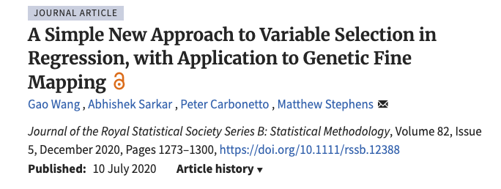
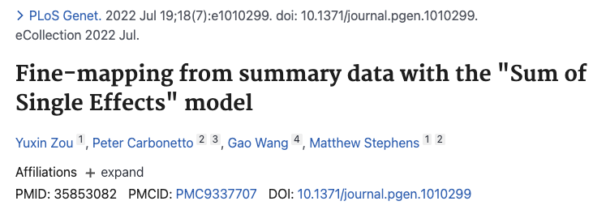
SuSiE
Requirements:
Individual level genotypes & phenotypes
OR
GWAS summary statistics & LD reference panel
Available as an R package

Slide 13
SuSiE Model
Goal:
find as many credible sets as the data supports, each with as few variables as possible.
Assign probabilities to variants in the credible sets
Idea:
Allow up to L causal variants
Create $b_{1}…b_{L}$ : “single effect vectors” which contain p variants and are assumed to capture at least one causal effect
$$y=X\sum_{l=1}^{L}{b_{l}+e}$$
$y$phenotype vector
$X$ genotype matrix
+
+
=
$b_{l}$ a p vector with one non-zero element
$L$ the maximum number of causal variants

Slide 14
SuSiE Regression
Intuition:
If we know all single-effect vectors except 1, ($b_{1}…b_{L−1})$, we can compute $b_{L}$ with a single-effect regression
But we don’t know $b_{1}…b_{L−1}$
Solution: Iterative algorithm
$$y=X\sum_{l=1}^{L}{b_{l}+e}$$
$y$phenotype vector
$X$ genotype matrix
$b_{l}$ a p vector with one non-zero element
$L$ the maximum number of causal variants
Iterative Bayesian Stepwise Selection Algorithm
Initialise ${\overline{b}}_{1}=…={\overline{b}}_{L}=0$
Repeat
For $l in 1,…,L$ do:
$y^{′}←y−\sum_{l^{′}≠l}{X{\overline{b}}_{l′}}$ compute residuals from fitting all other $l$s
Fit single-effect regression model to residuals $y^{′}=Xb_{l}+e$ & compute PIPs, credible set and posterior mean ${\overline{b}}_{1}$
Until converged

Slide 15
Illustrative Example
A locus with 10 SNPs, setting L=4,
maximum 20 iterations
Low PIP
High PIP
Initialisation
Iteration 1
Iteration 1
Iteration 1
Set all PIPs to 0
Fit l=1
Fit l=2
Fit l=3
SNP10
SNP5
SNP9
SNP1
SNP6
SNP8
SNP2
SNP4
SNP7
SNP3
$$b_{1}$$
$$b_{1}$$
$$b_{1}$$
$$b_{2}$$
$$b_{2}$$
$$b_{2}$$
$$b_{3}$$
$$b_{3}$$
$$b_{3}$$
$$b_{4}$$
$$b_{4}$$
$$b_{4}$$
$$b_{4}$$
Fit $b_{2}+b_{3}+b_{4}$ to model
Fit $b_{1}$ to residuals
Calculate PIPs
Fit $b_{1}+b_{3}+b_{4}$ to model
Fit $b_{2}$ to residuals
Calculate PIPs
Fit $b_{1}+b_{2}+b_{4}$ to model
Fit $b_{3}$ to residuals
Calculate PIPs
$$b_{1}$$
$$b_{2}$$
$$b_{3}$$

Slide 16
Illustrative Example
A locus with 10 SNPs, setting L=4,
maximum 20 iterations
Low PIP
High PIP
Iteration 5
Iteration 5
Iteration 5
Iteration 5
l=1
l=2
l=3
l=4
$$b_{1}$$
$$b_{1}$$
$$b_{1}$$
$$b_{2}$$
$$b_{2}$$
$$b_{2}$$
$$b_{3}$$
$$b_{3}$$
$$b_{3}$$
$$b_{4}$$
$$b_{4}$$
$$b_{4}$$
Fit $b_{2}+b_{3}+b_{4}$ to model
Fit $b_{1}$ to residuals
Calculate PIPs
Fit $b_{1}+b_{3}+b_{4}$ to model
Fit $b_{2}$ to residuals
Calculate PIPs
Fit $b_{1}+b_{2}+b_{4}$ to model
Fit $b_{3}$ to residuals
Calculate PIPs
Fit $b_{1}+b_{2}+b_{4}$ to model
Fit $b_{3}$ to residuals
Calculate PIPs
$$b_{1}$$
$$b_{2}$$
$$b_{3}$$
$$b_{4}$$

Slide 17
Illustrative Example
A locus with 10 SNPs, setting L=4,
maximum 20 iterations
Low PIP
High PIP
Convergence!
Iteration 12
Iteration 12
Iteration 12
Iteration 12
l=2
l=3
l=4
l=1
$$b_{1}$$
$$b_{1}$$
$$b_{1}$$
$$b_{2}$$
$$b_{2}$$
$$b_{2}$$
$$b_{3}$$
$$b_{3}$$
$$b_{3}$$
$$b_{4}$$
$$b_{4}$$
$$b_{4}$$
Fit $b_{2}+b_{3}+b_{4}$ to model
Fit $b_{1}$ to residuals
Calculate PIPs
Fit $b_{1}+b_{3}+b_{4}$ to model
Fit $b_{2}$ to residuals
Calculate PIPs
Fit $b_{1}+b_{2}+b_{4}$ to model
Fit $b_{3}$ to residuals
Calculate PIPs
Fit $b_{1}+b_{2}+b_{3}$ to model
Fit $b_{4}$ to residuals
Calculate PIPs
$$b_{1}$$
$$b_{2}$$
$$b_{3}$$
$$b_{4}$$

Slide 18
Illustrative Example
A locus with 10 SNPs, setting L=4,
maximum 20 iterations
Low PIP
High PIP
PIPs after 12 iterations
95% Credible Sets
SNP10
SNP5
SNP9
SNP1
SNP6
SNP8
SNP2
SNP4
SNP7
SNP3
$$b_{1}$$
SNP2, SNP3, SNP4
$$b_{2}$$
SNP7, SNP8, SNP9,
SNP10
$$b_{3}$$
No CS formed
$$b_{4}$$
No CS formed

Slide 19
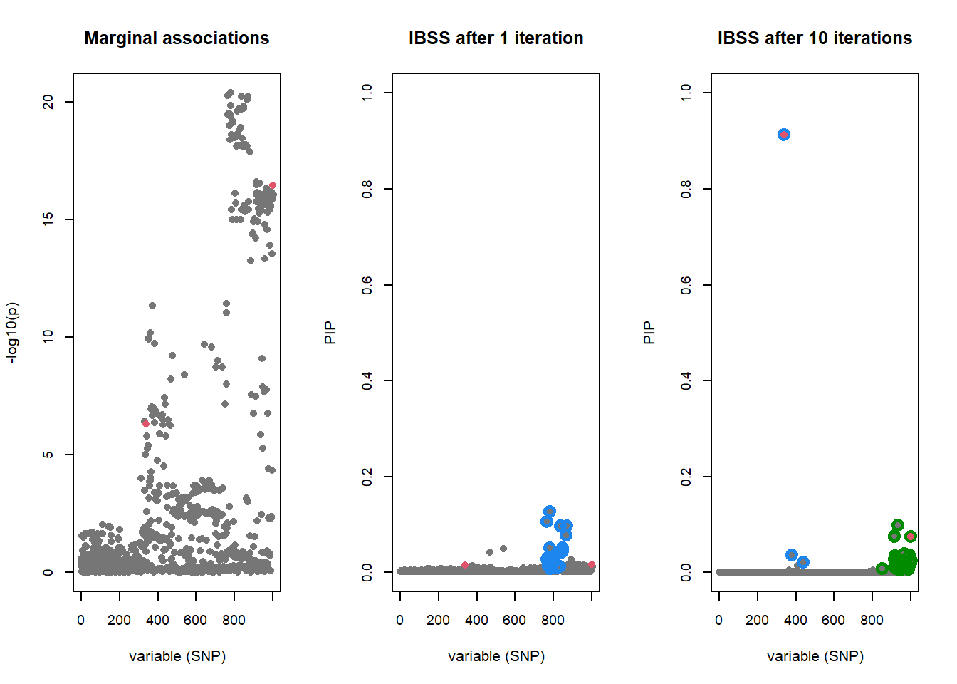
A simulated example
https://stephenslab.github.io/susie-paper/manuscript_results/pedagogical_example.html

Slide 20
Considerations for SuSiE
Density of locus
Well-matched LD
Measurement error (e.g. imputation)
Additive model
Binary vs quantitative trait
Assumption of sparse effects
Ground truth
Simulations: calibration
Real data: replication rate

Slide 21
Many methods!
Multiple causal variants
SuSiE (Wang, 2020)
CAVIAR (Hormodiari, 2014)
FINEMAP (Benner, 2016)
COJO-ABF (Yang, 2012)
Different assumptions of causal effect distribution
Why? Wrong assumptions on polygenicity can lead to miscalibration
SuSiE-Inf, FINEMAP-Inf (Cui, 2024)
Integrate functional data
Why? Biologically-informed
PolyFun (Wiessbrod 2020)
PAINTOR (Kichaev, 2020)
fastPAINTOR (Kichaev, 2017)
SuSiE² (Zhang, 2024)
Multiple tissues/cell-types
Why? Complex diseases have tissue-specific mechanisms
TGFM (Strober, 2025)
Multi ancestry
Why? Less LD, more samples
MESuSiE (Gao, 2024)
SuSiEx (Yuan, 2023)
MultiSuSiE (Rossen, 2024)
Genome-wide
Why? Considers global genetic architecture
GWFM (Wu, 2025)
& more!

Slide 22
Additional Resources
https://youtu.be/pglYf7wocSI
https://pmc.ncbi.nlm.nih.gov/articles/PMC7733401/
https://stephenslab.github.io/susieR/articles/finemapping_summary_statistics.html
https://cnsgenomics.com/data/teaching/GNGWS23/module1/11_fine-mapping.html
https://www.youtube.com/watch?v=QL3YawgTPhc
https://www.youtube.com/watch?v=S6vfOr336b0
https://annahutch.github.io/PhD/SuSiE.html
https://www.youtube.com/watch?v=c6RCLLxS3EA
https://stephenslab.github.io/susie-paper/manuscript_results/pedagogical_example.html

Slide 23
Practical!

