Slide 1
Resources for Post GWAS Analysis
SMARTbiomed Summer School 2025
Isabelle McGrath

Slide 2
GWAS to Biological Understanding
Associated Locus → Causal SNP → Gene → tissue/cell type → Pathway → Trait
Benefits
Understand biological underpinnings of disease
Which genes
Which cell types/tissues
Which timepoints
Inform drug development
Challenges
Linkage disequilibrium = many non-causal associated SNPs
Most associations lie outside exons
Causal effect may be context-specific

Slide 3
Drug development applications
Drug development is an arduous process
GWAS can be used to find gene-trait pairs, find intersection with target-indication pair
Genetic evidence for drug mechanism increases probability of drug success by 2.6x
Largest effect in phase II and III, less so in phase I
Minikel, 2024
Notes:
https://www.nature.com/articles/s41586-024-07316-0

Slide 4
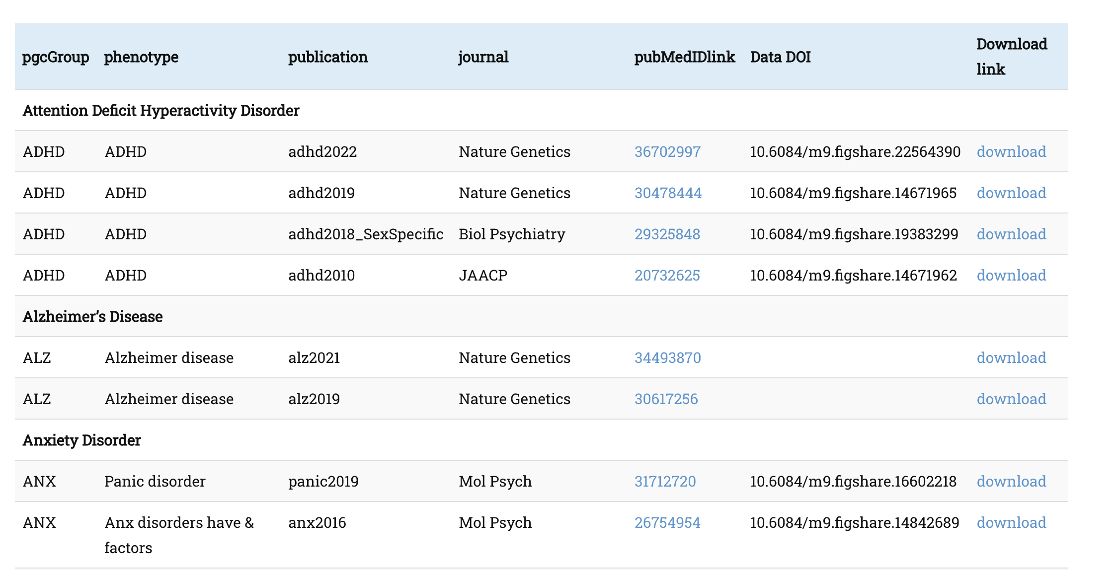
Publicly Available GWAS Summary Statistics

Slide 5
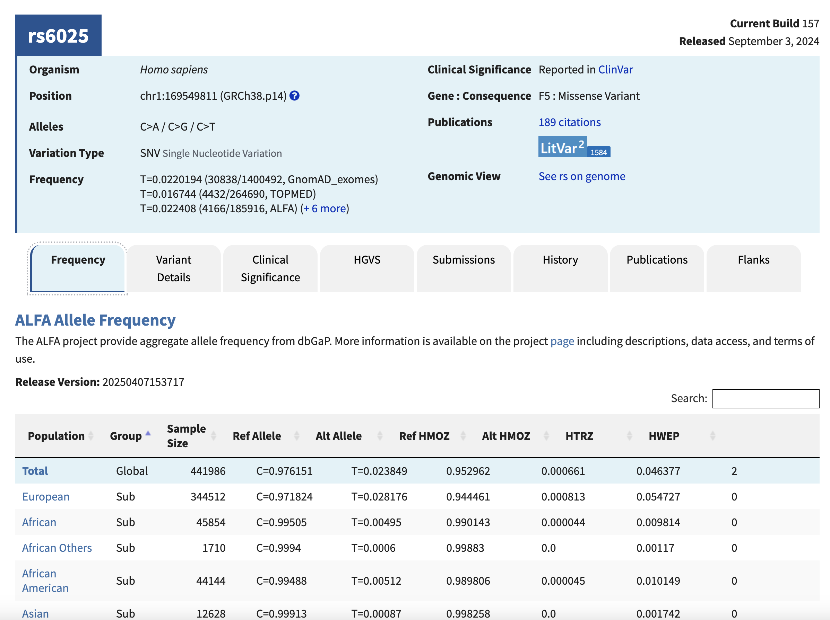
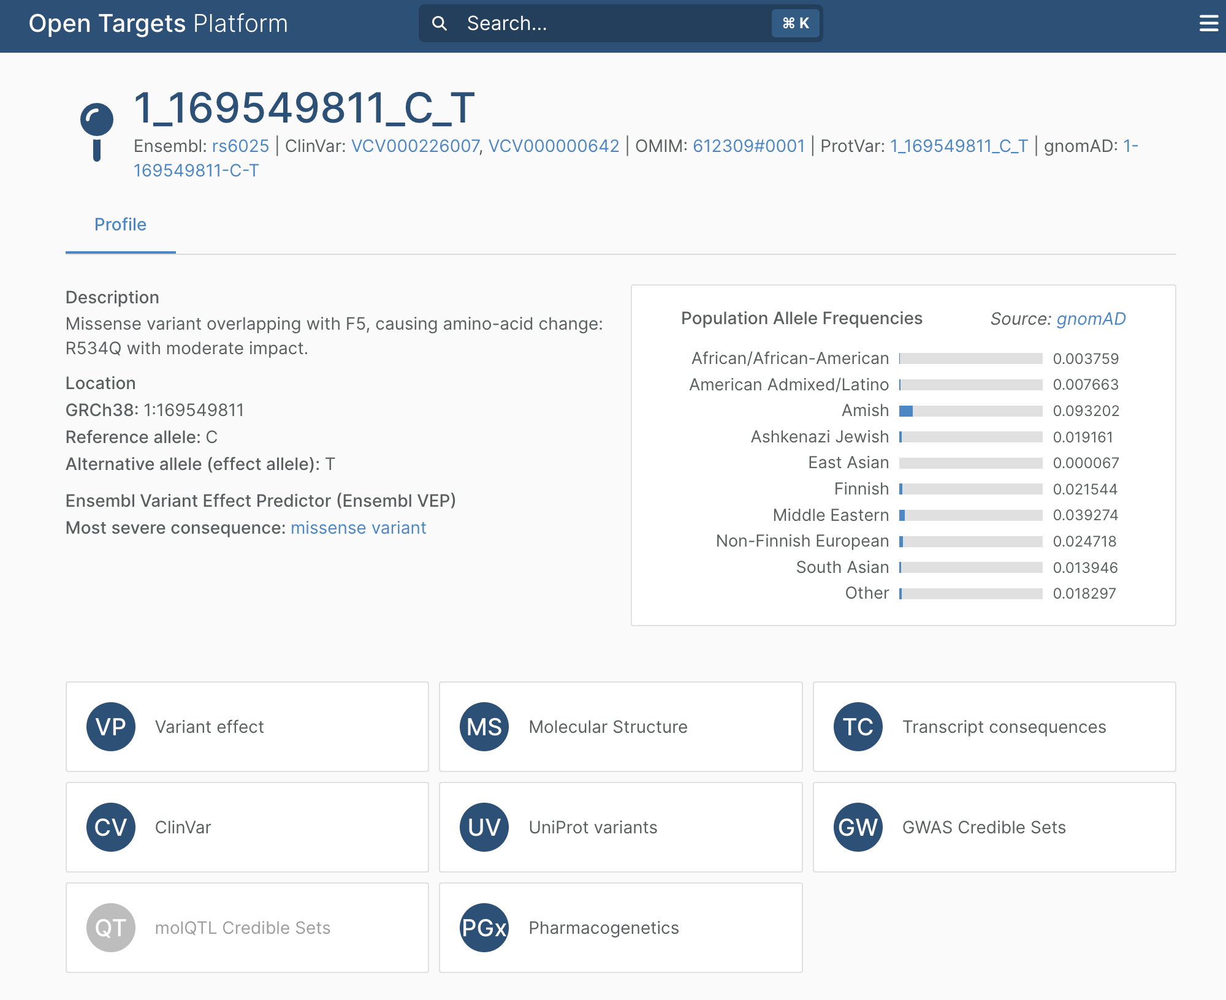
Online Resources Individual Variants
dbSNP
OpenTargets
Notes:
Frequencies by population
Publications
Clinical significance
Position by genome version
Visualise locus

Slide 6
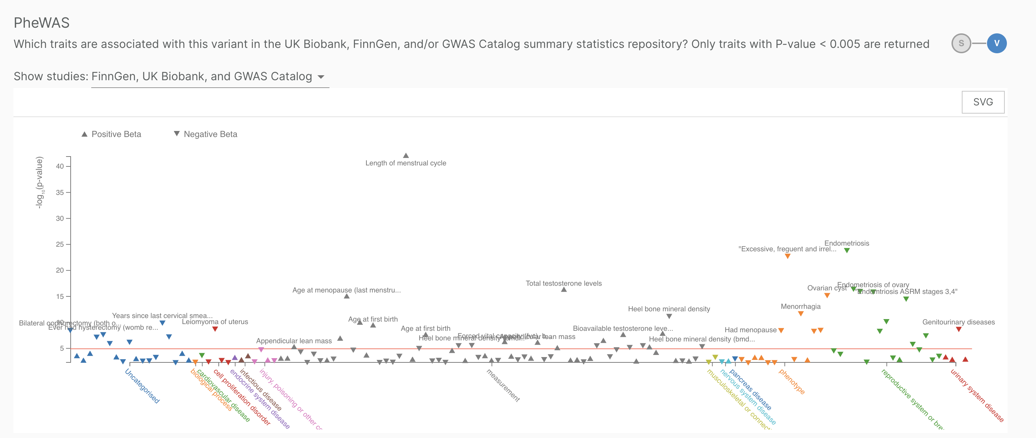
PheWAS
GWAS: test many genotypes with a phenotype
PheWAS: test phenotypes with a genotype
OpenTargets

Slide 7
Exome-based association statistics
Notes:
SAIGE-GENE,¹⁶ which includes single-variant tests and gene-based burden (mean), SKAT (variance), and SKAT-O (hybrid variance/mean) tests (Figure S7).

Slide 8
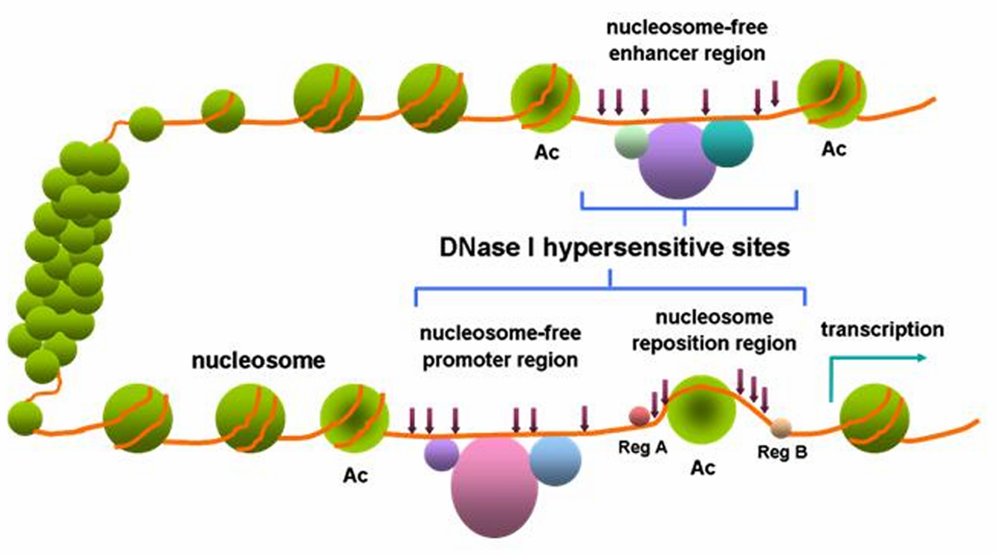
Where are the GWAS hits?
DNaseI hypersensitivity sites (DHS) (open chromatin) covered 16% of imputed SNPs but explained 79% of $h_{g}^{2}$from imputed SNPs (5.1x enrichment) (11 traits, 217 cell types)
Wikipedia
Gusev, 2014
Notes:
https://www.cell.com/ajhg/fulltext/S0002-9297(14)00426-1?_returnURL=https%3A%2F%2Flinkinghub.elsevier.com%2Fretrieve%2Fpii%2FS0002929714004261%3Fshowall%3Dtrue
DNaseI hypersensitivity sites (DHSs)
Associated with open chromatin, and thus accessibility to regulatory elements and transcriptional activity.
Maps to regulatory elements (promoters, enhancers, insulators, silencers)
Accessibility of regulatory regions is highly cell type- and state-selective

Slide 9
The Central Dogma
Exon
Intron
Genomic DNA
Transcription
Pre-mRNA
Splicing
mRNA
Translation
Protein

Slide 10
Molecular Quantitative Trait Loci (molQTLs)
cisQTL: variant affects a nearby molecular trait
transQTL: variant affects a distal molecular trait (e.g. a gene on another chromosome)
Aguet, 2023 & Brandt, 2017
Notes:
https://www.nature.com/articles/s43586-022-00188-6
The true biological definition for cis-regulatory associations is that the effects are driven by molecular interactions of the same chromatid rather than trans effects mediated by other molecules, but the distance-based heuristic is commonly used in practice and has been demonstrated to be a good approximation.

Slide 11
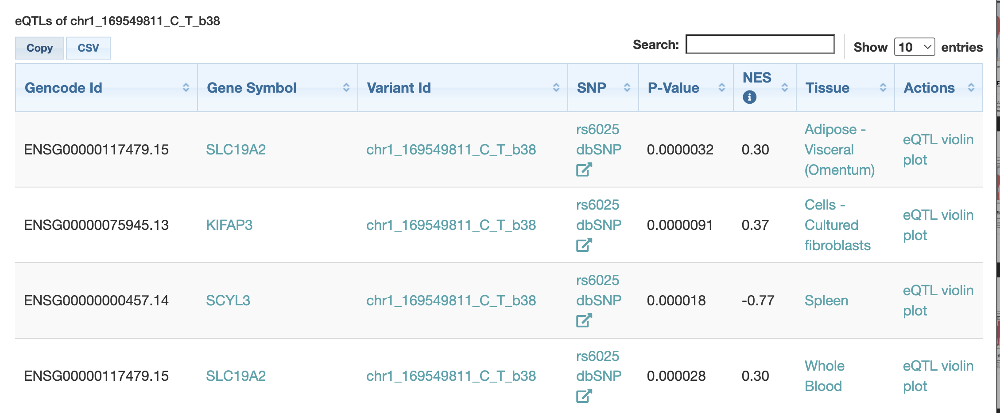
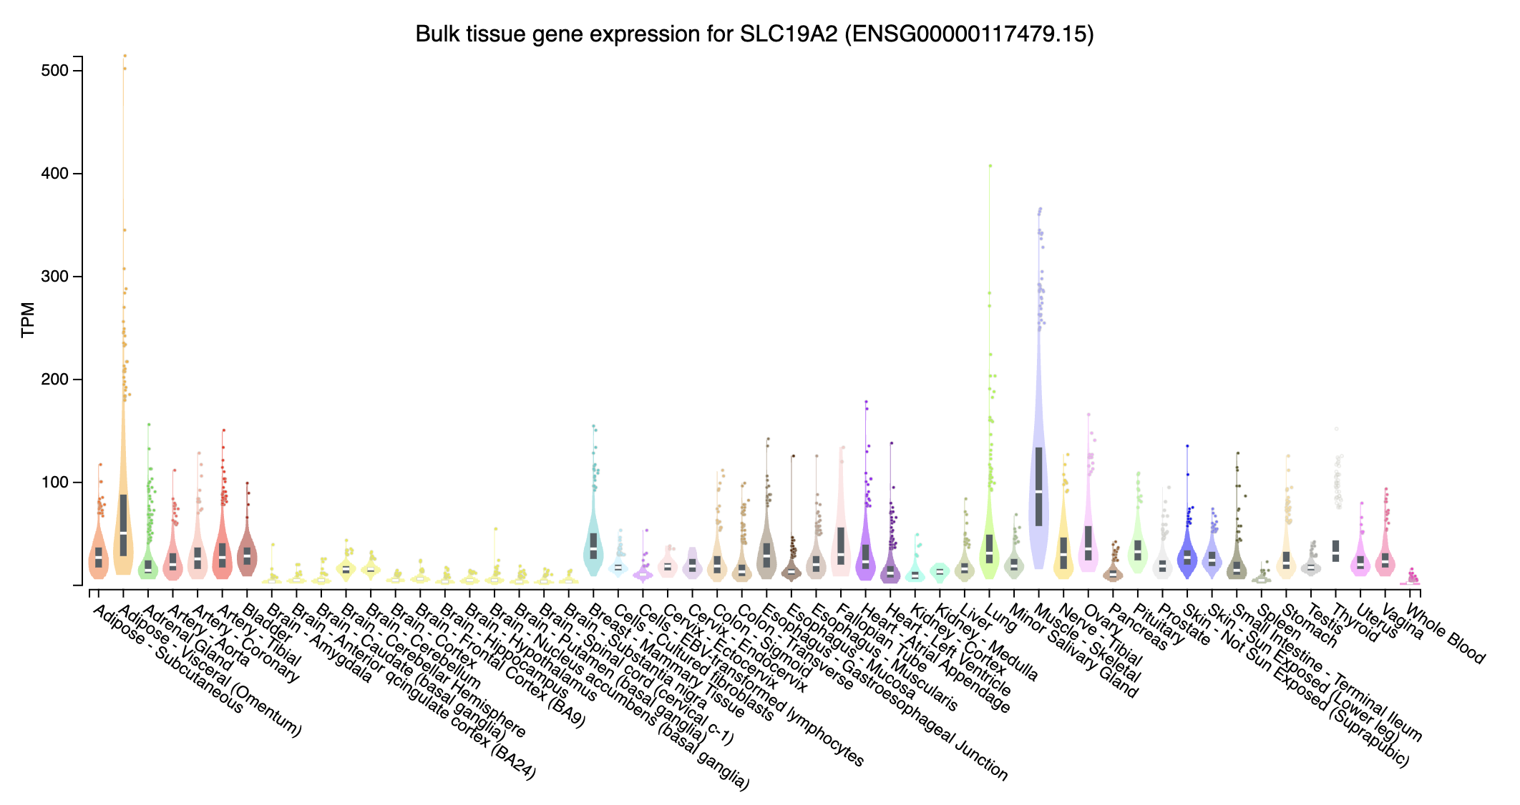
GTEx

Slide 12
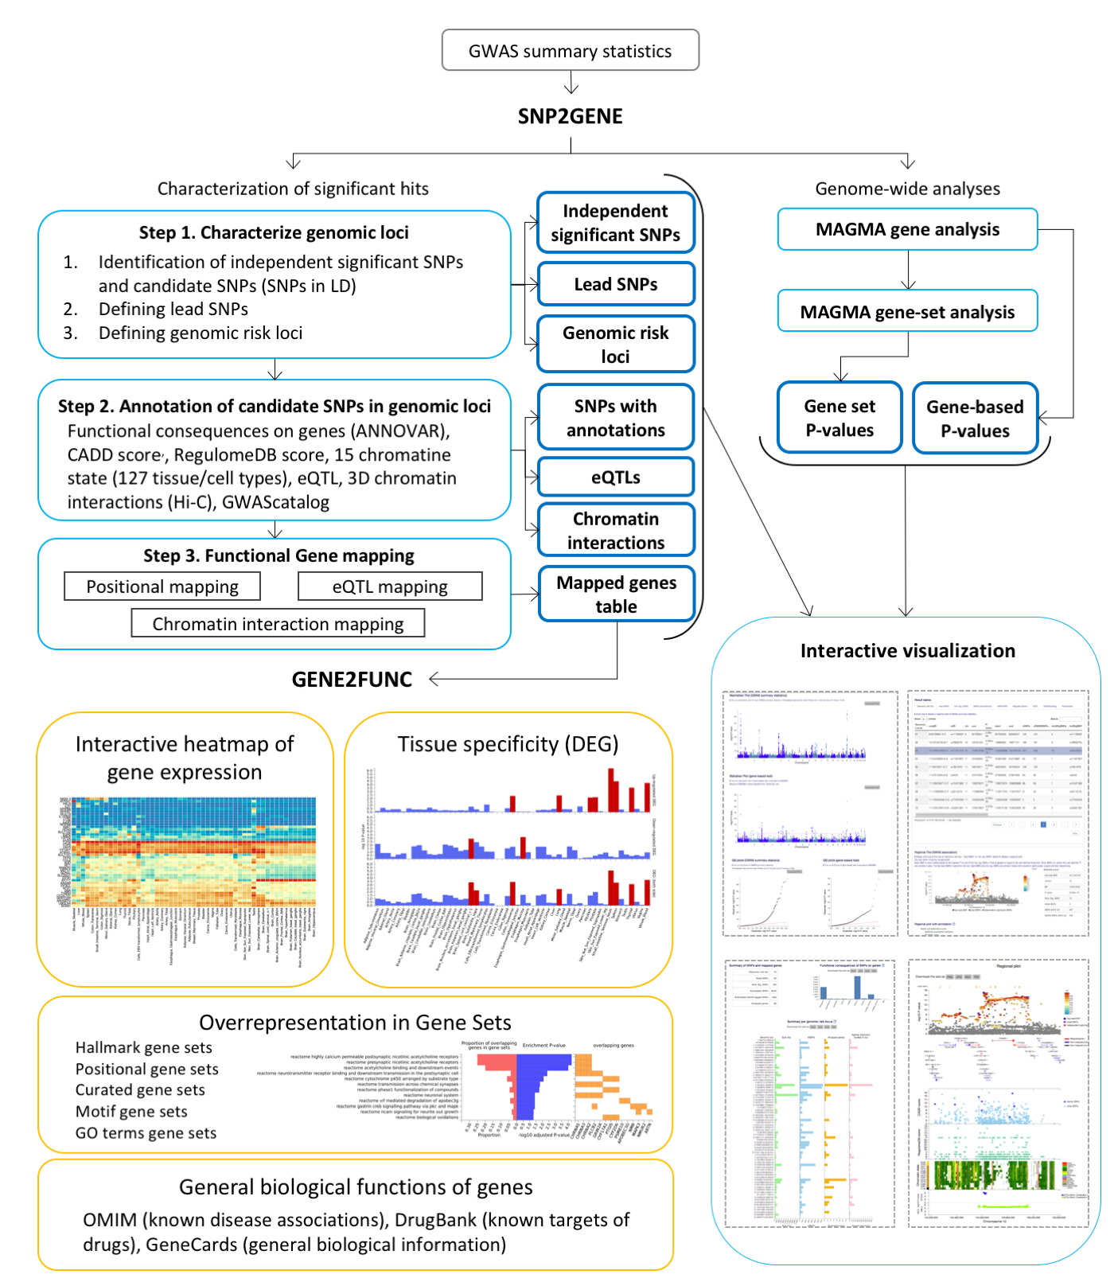
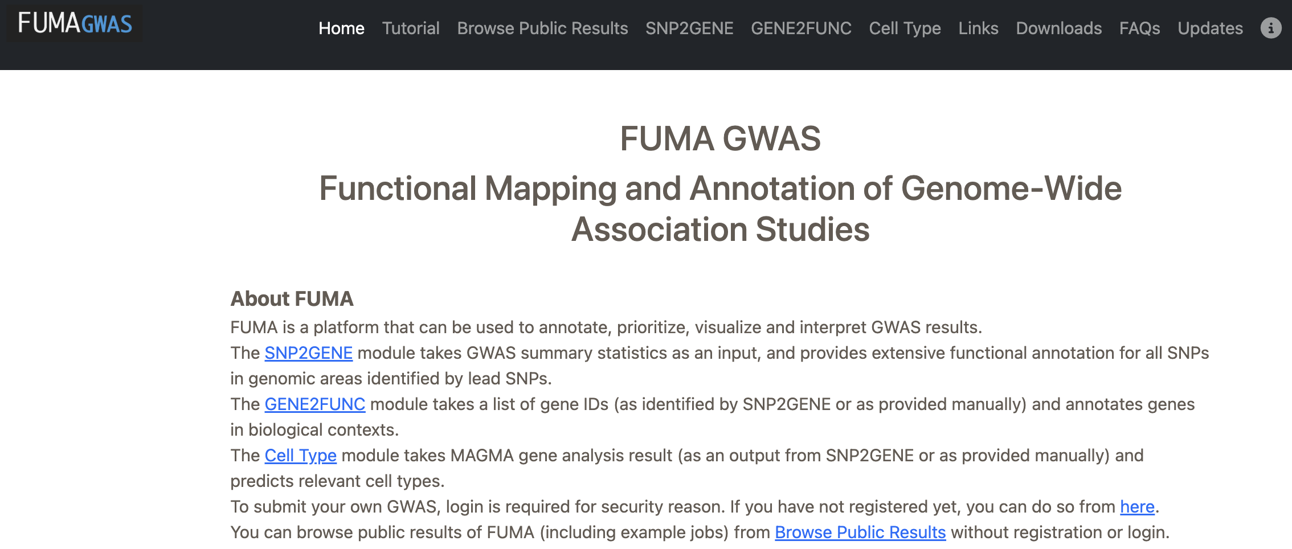
FUMA: GWAS Annotation

Slide 13
More to come on post-GWAS analysis methods!
Genetic Correlation: genome-wide genetic correlation between two traits
Local genetic correlation: genetic correlation within LD blocks between traits
Structural Equation Modelling: model the relationships between traits using their genetic architecture
Partitioned heritability: Heritability partitioned by functional annotation
Gene-based tests: aggregate association into genes
Colocalisation: Do two traits share a causal variant?
Gene expression signature of a trait: combine eQTLs within GWAS summary statistics to determine gene expression signature
And many more!

